Slide 1
ELOS ECOMMERCE WEB APPLICATION
Github Repository: https://github.com/Jiulio7Costa/uniPortfolio
Name: D.A.Jiulio costa Matriculation no:92131404

Slide 2
Purpose of the web application
This web application is designed to help individuals who find it difficult to afford high-priced, brand-new electronic devices. By offering affordable, used electronics with a warranty, we provide customers with a reliable and cost-effective alternative. The platform aims to make technology more accessible to everyone, ensuring peace of mind with warranty protection on every purchase.

Slide 3
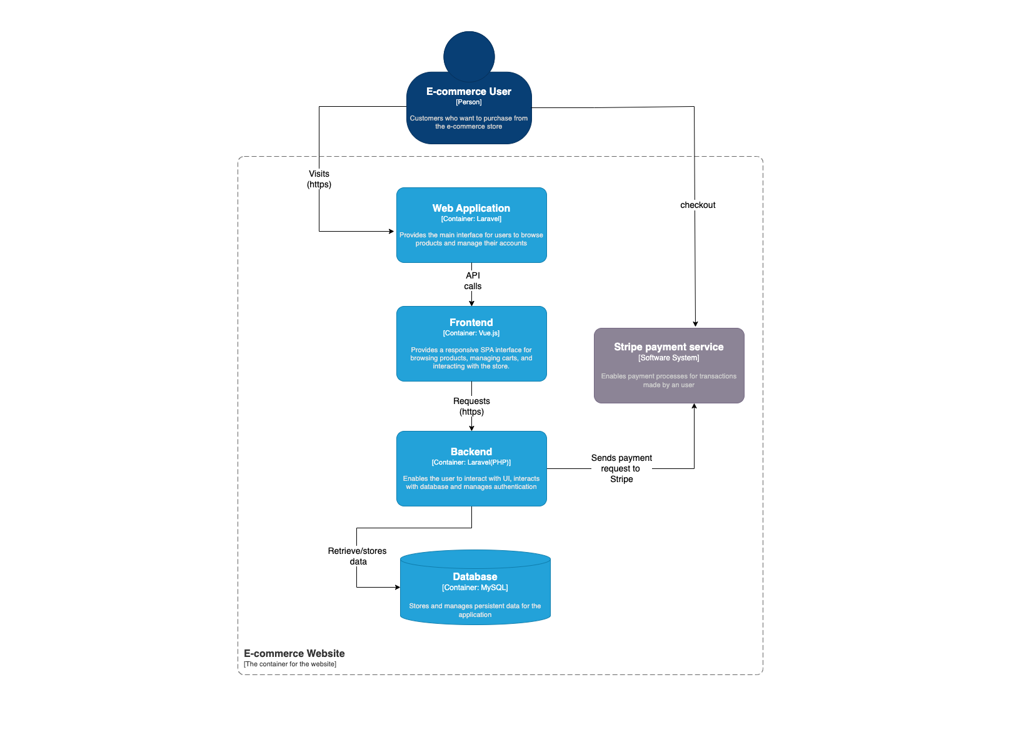
Architecture Diagram

Slide 4
Technology Choices
Frontend: Inertia.js with vue.js 3
Backend: Laravel(PHP)
Database: MySQL

Slide 5
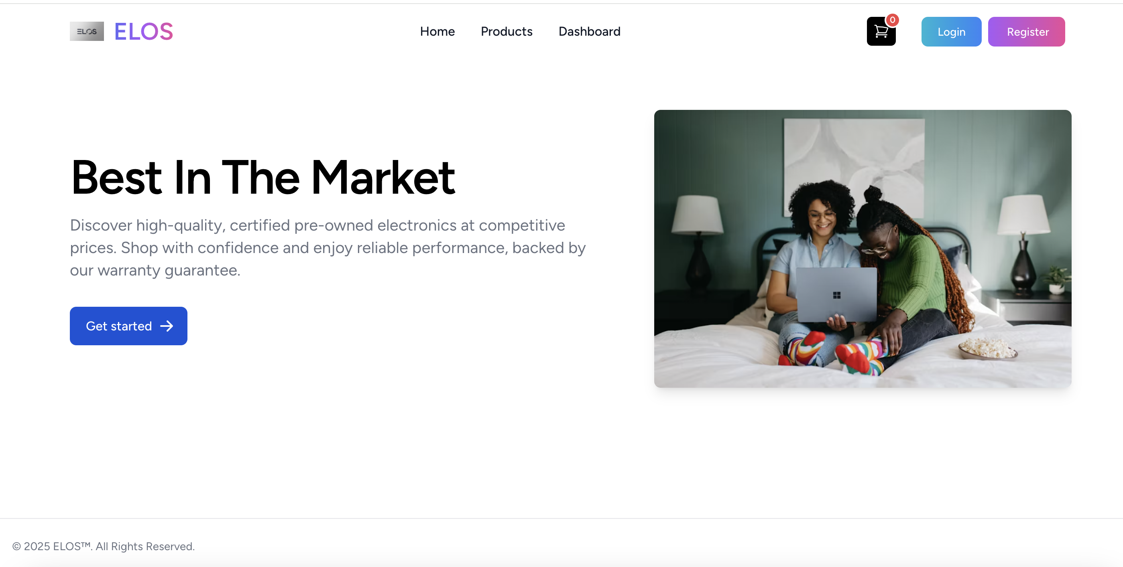
Annotated screenshots of the web Application
New user can register and use the registered data to login.
Existing or new users after regeristering can login to website.
Cart list will be here when user adds a product they can see what they have added in the cart
To access the dashboard the user must be logged in, guest user have no access. The dashboard shows the overview of a transaction when a product is checked out
When a user clicks here they will be directed to products page

Slide 6
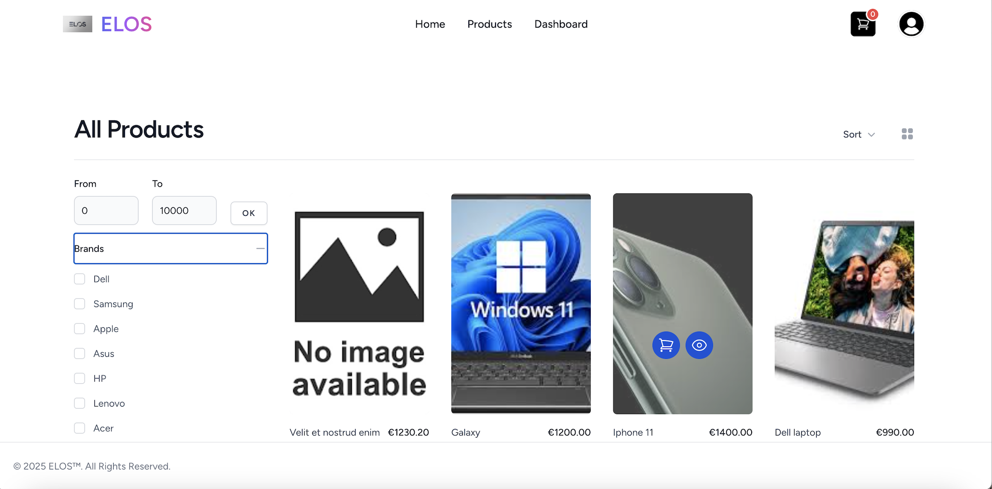
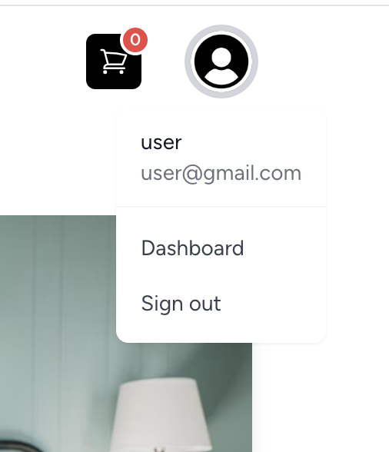
After the user is logged in, the login and register buttons disappear and user profile is shown
When hovered over the product, the eye icon will appear and when clicked it will take user to product details
When hovered over, the cart icon appears and when user clicks it the product will be added to black cart icon
The user can filter the products by price and click ok
User can click + sign next to brands and dropdown will appear where user can filter by brands.Below it there is the categories with same functionality
When user clicks on user profile the dropdown will allow the user to visit dashboard and signout

Slide 7
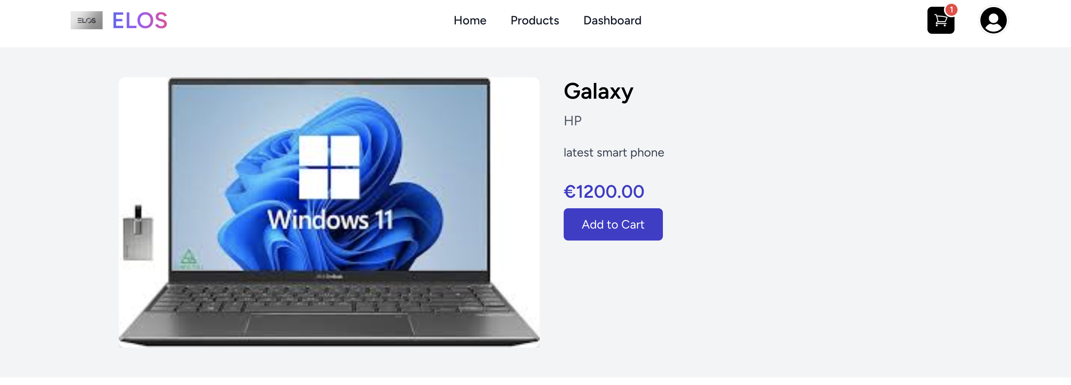
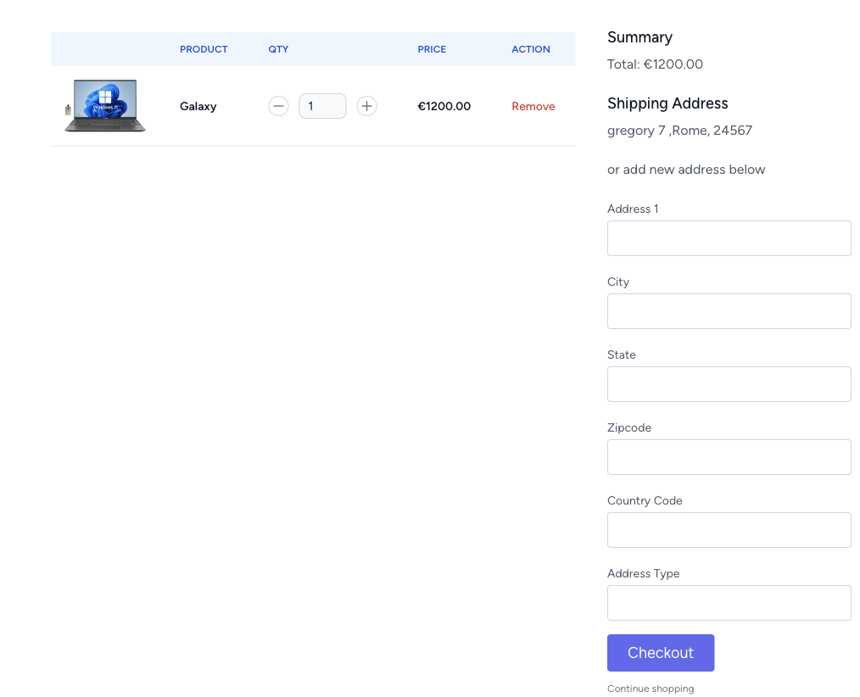
When the user add a product to cart the quantity will be shown in the small red circle
If the product has muliple images there will be a slider,but if it is a single there won’t appear a slide. On the right side is the product details with product name,brand descritption(put size and colour info) and price
User can remove product from cart list
User can change quanitity increase or decrease, the total will also change accordingly
The user will enter the address, if user has previously entered a address it will be saved above, to access checkout page user must be logged in, else will be directed to login page.

Slide 8
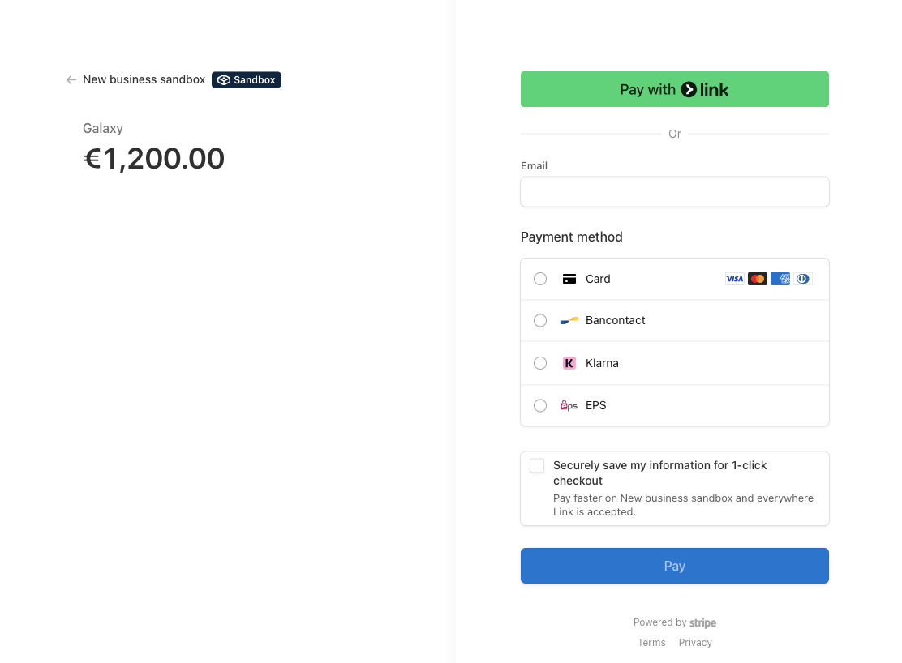
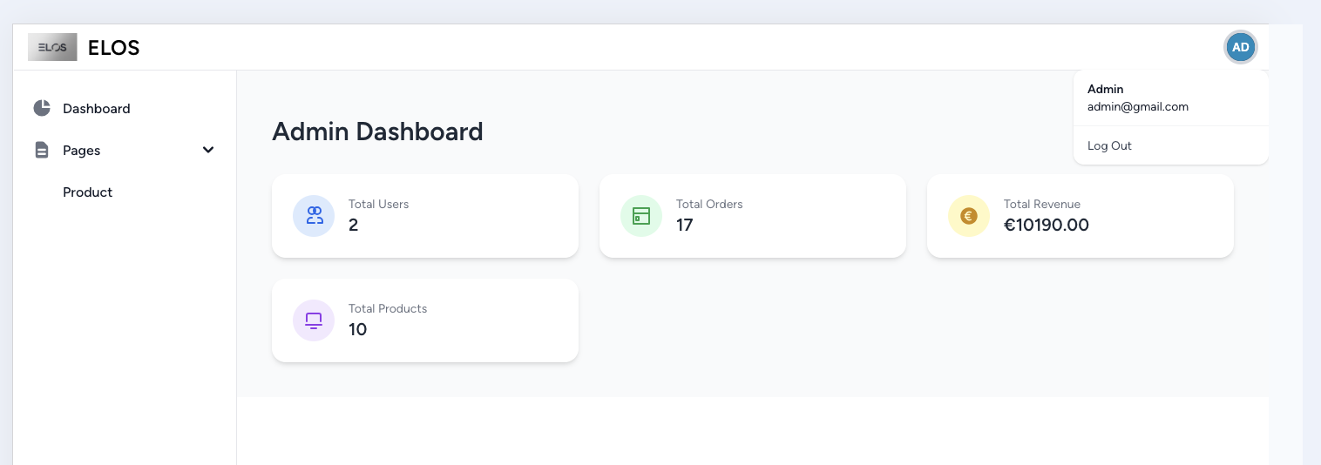
When the user clicks checkout in cartlist page ,the user will be redirected to stripe. The user will see product total and pay with their preferred choice.
When payment is successful the user will be directed to the dashboard with the summary of transaction.
Admin profile with logout option
Admin dashboard with important store data, total revenue updates when a user payment is paid.

Slide 9
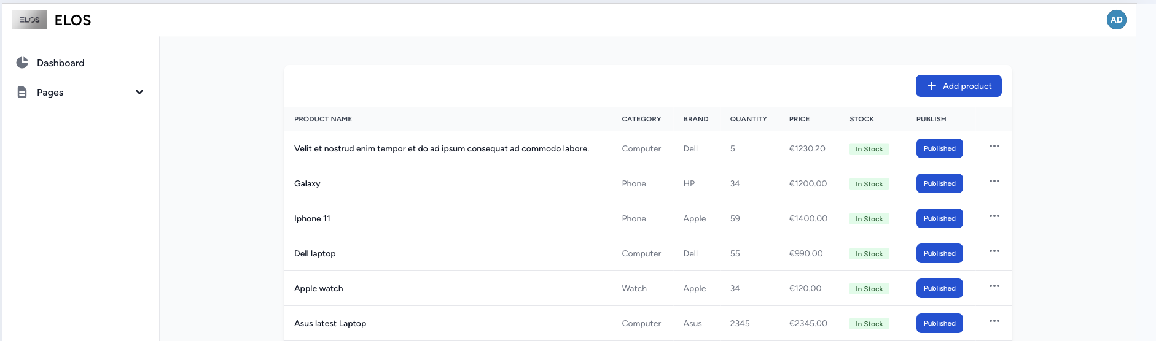
Most important functionality is here, the three dots where editing and deleting product functionalities are provided
Under pages , the prodcut page has all functionalities to manage the products in the platform
Adding product is done in here with possibilty to add multiple product images as well

Slide 10
Changes compared to phase 1
Compared to Phase 1, the purpose of the website has evolved. Initially, it was designed as a general eCommerce platform selling a wide variety of products targeted at consumers with busy lifestyles. Now, the focus has shifted to a more niche market reselling electronic products with a guaranteed warranty, aiming to serve each customer with greater trust, affordability, and value.

Slide 11
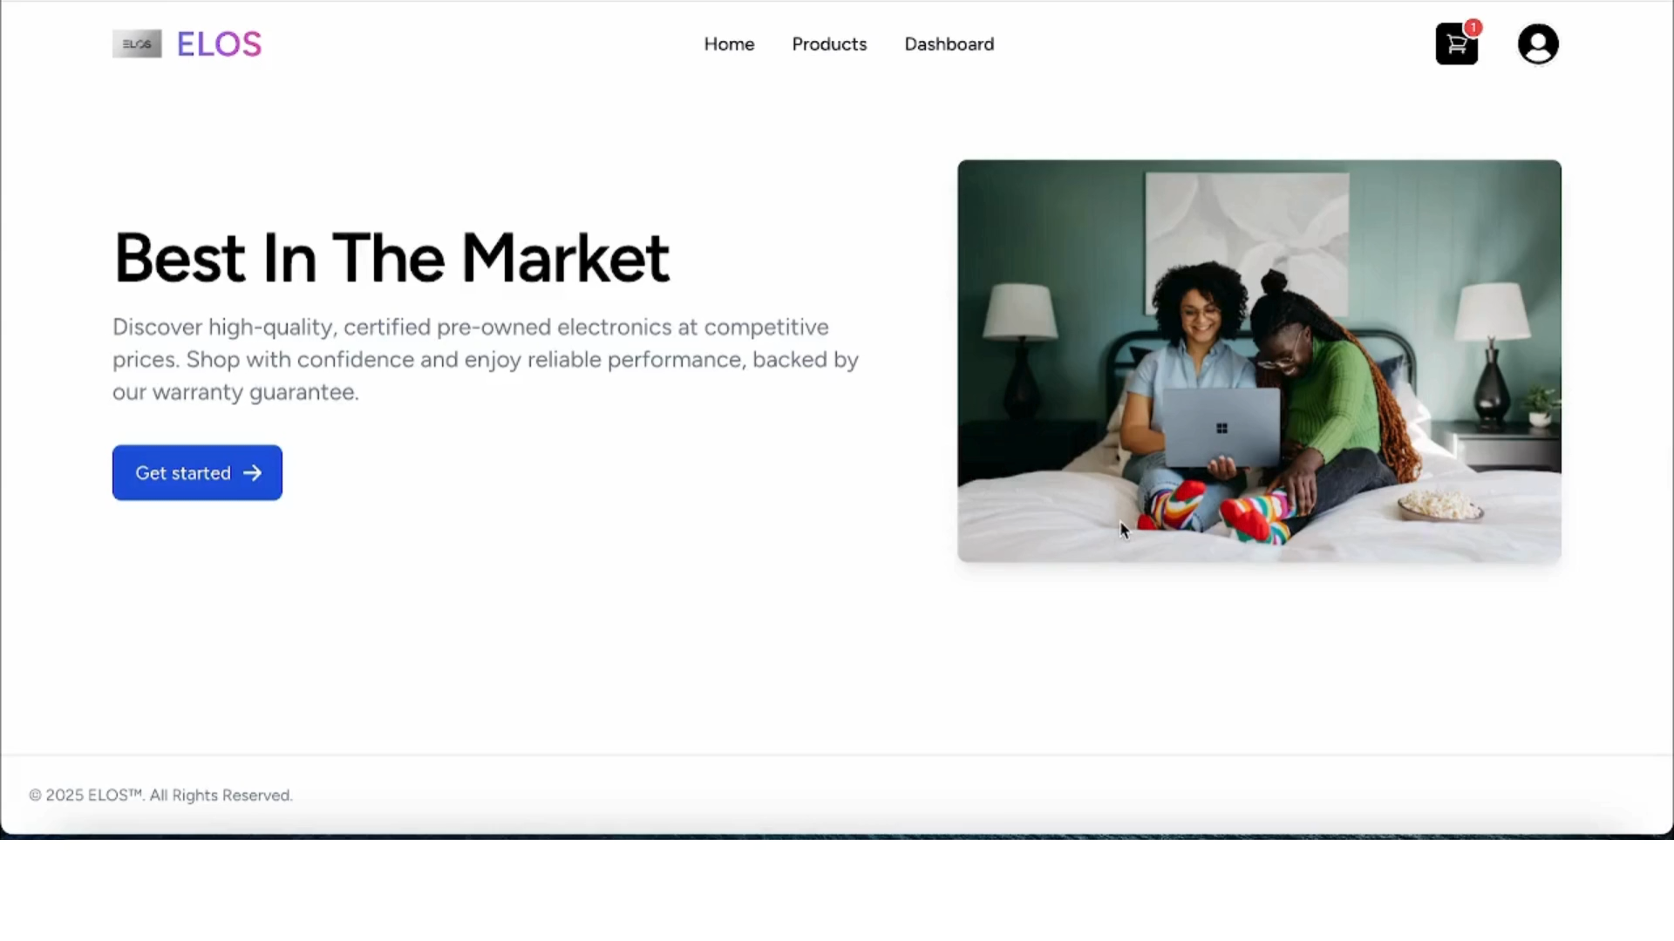
Demo video

